Slide 1

Joy of Painting
Lisa Over HW 07 CMPINF 2110 April 23, 2021

Slide 2
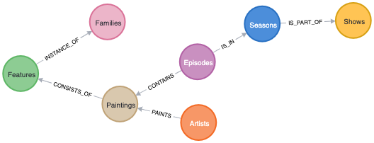
Joy of Painting Graph Data Model Schema

Slide 3
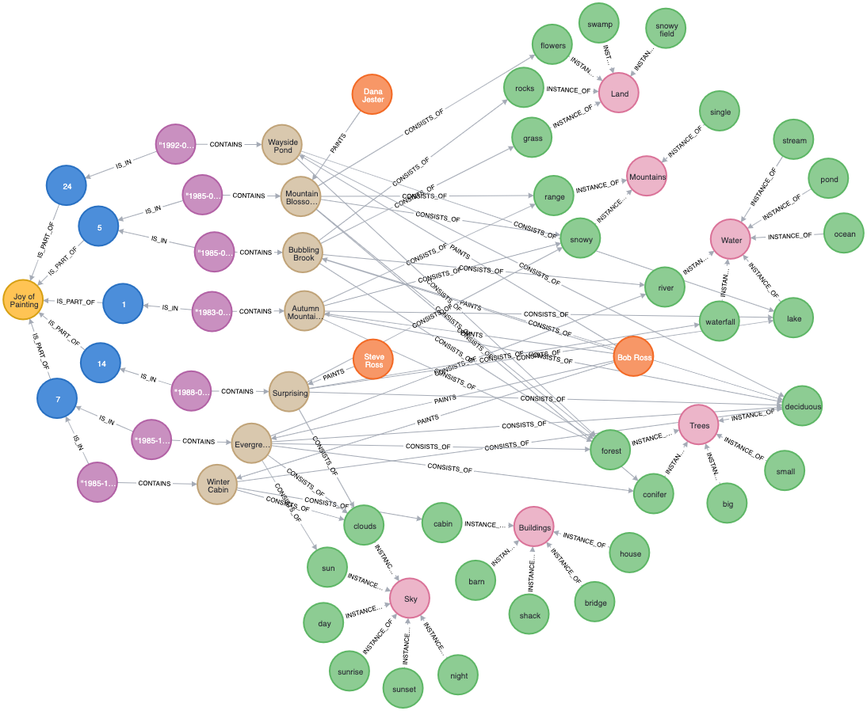
All Nodes and Relationships

Slide 4
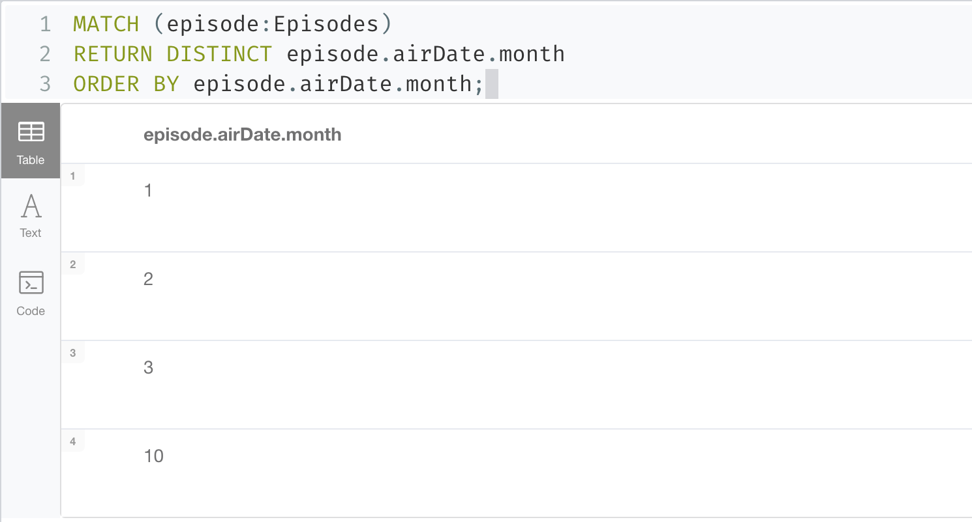
Unique Episode Air Date Months
Notes:
MATCH (episode:Episodes)
RETURN DISTINCT episode.airDate.month
ORDER BY episode.airDate.month;
With APOC (offline mode must be disabled)
MATCH (episode:Episodes)
RETURN DISTINCT apoc.temporal.format( episode.airDate.month, 'MMM-YYYY-dd’)
ORDER BY episode.airDate.month;

Slide 5
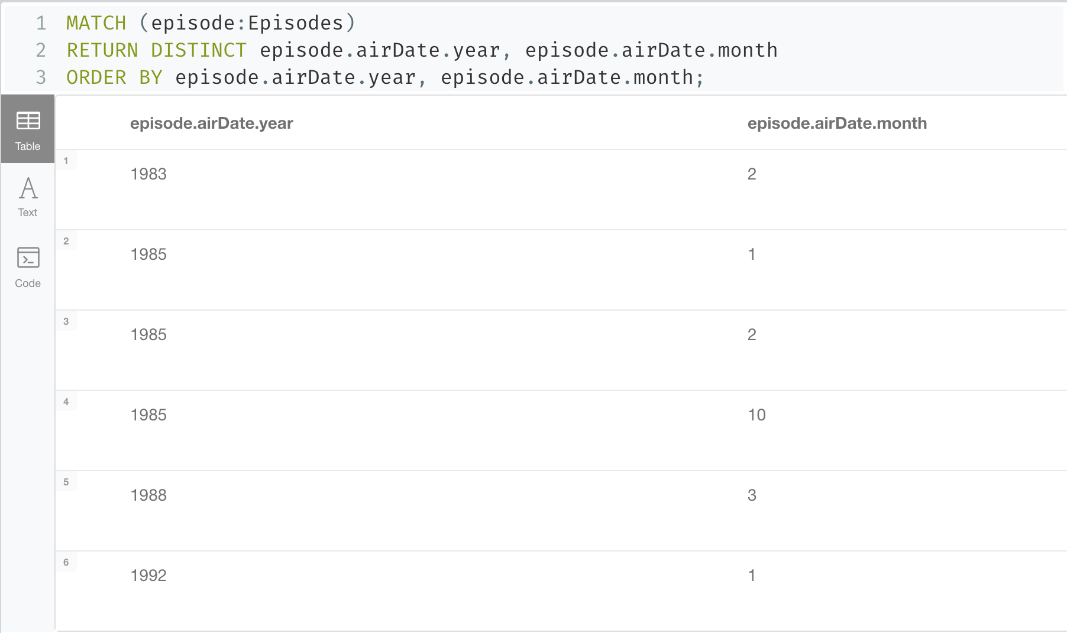
Unique Episode Air Date Months Each Year
Notes:
MATCH (episode:Episodes)
RETURN DISTINCT episode.airDate.year, episode.airDate.month
ORDER BY episode.airDate.year, episode.airDate.month;
With APOC (offline mode must be disabled)
MATCH (episode:Episodes)
RETURN DISTINCT apoc.temporal.format( episode.airDate.month, 'MMM-YYYY-dd'), episode.airDate.year
ORDER BY episode.airDate.year, episode.airDate.month;

Slide 6
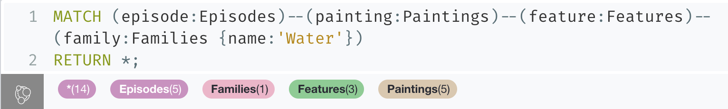
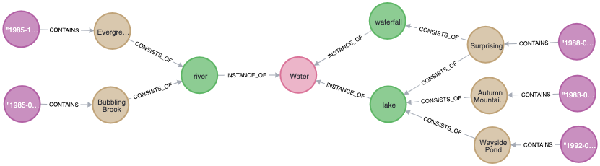
Episodes Containing Features from the Water Feature Family
Notes:
MATCH (episode:Episodes)--(painting:Paintings)--(feature:Features)--(family:Families {name:'Water'})
RETURN *;

Slide 7
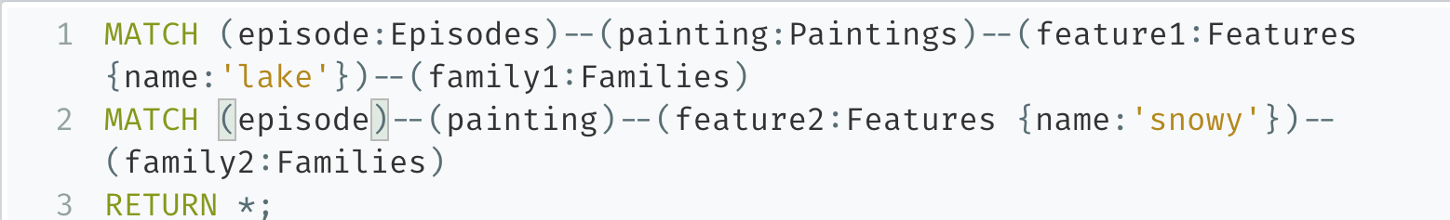
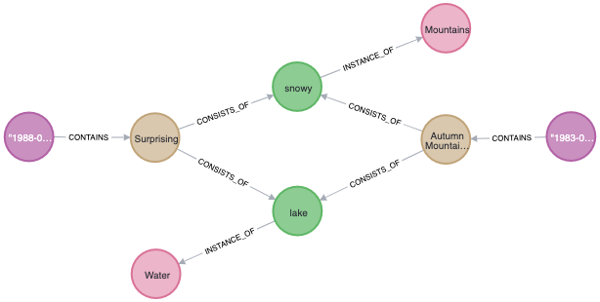
Episodes Containing Snowy Mountain and Lake
Notes:
MATCH (episode:Episodes)--(painting:Paintings)--(feature1:Features {name:'lake'})--(family1:Families)
MATCH (episode)--(painting)--(feature2:Features {name:'snowy'})--(family2:Families)
RETURN *;

